Slide 1
PRODUCT MANAGEMENT SYSTEM
ARCHANA BATHULA
2021-6312
EBEON1121461210

Slide 2
Overview
Springboot-backend: This project is used to develop CRUD RESTFul APIs for a simple Product Management System using Spring Boot, JPA, and MySQL as a database.
Angular-frontend: This project is used to develop single page application using Angular as front-end technology. This Angular application consumes CRUD Restful APIs developed and exposed by a springboot-backend project.

Slide 3
Angular Spring boot Full-Stack Architecture
Angular Frontend App
Templates
Components
Services
HTTP Client
Spring Boot Backend App
Spring REST Controller
DB
Models
Services
DAO
(Repositiory)

Slide 4
Tools and technologies used
Server-side technologies
Spring Boot
JDK - 13.0.2
Spring Data JPA (Hibernate) with MySQL
Front end technologies
Angular
NodeJs and NPM
Tools
Maven
IDE - Spring Tool Suite (STS)
Visual Studio Code
Angular CLI

Slide 5
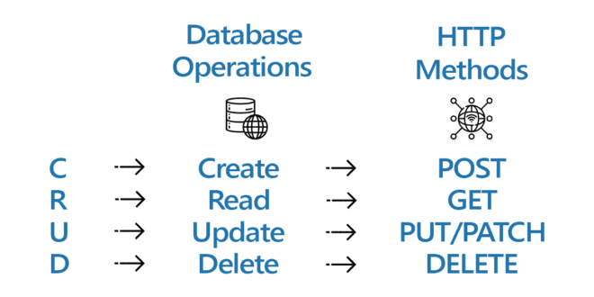
CRUD Operations

Slide 6
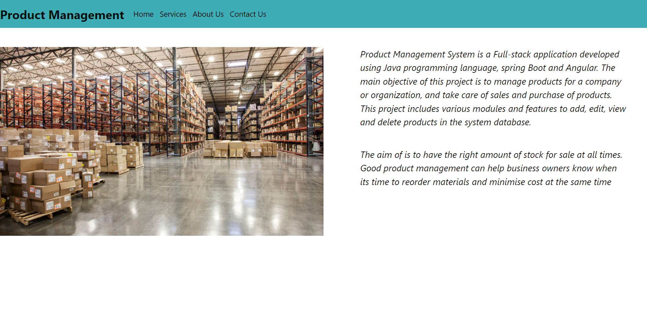
Home Page

Slide 7
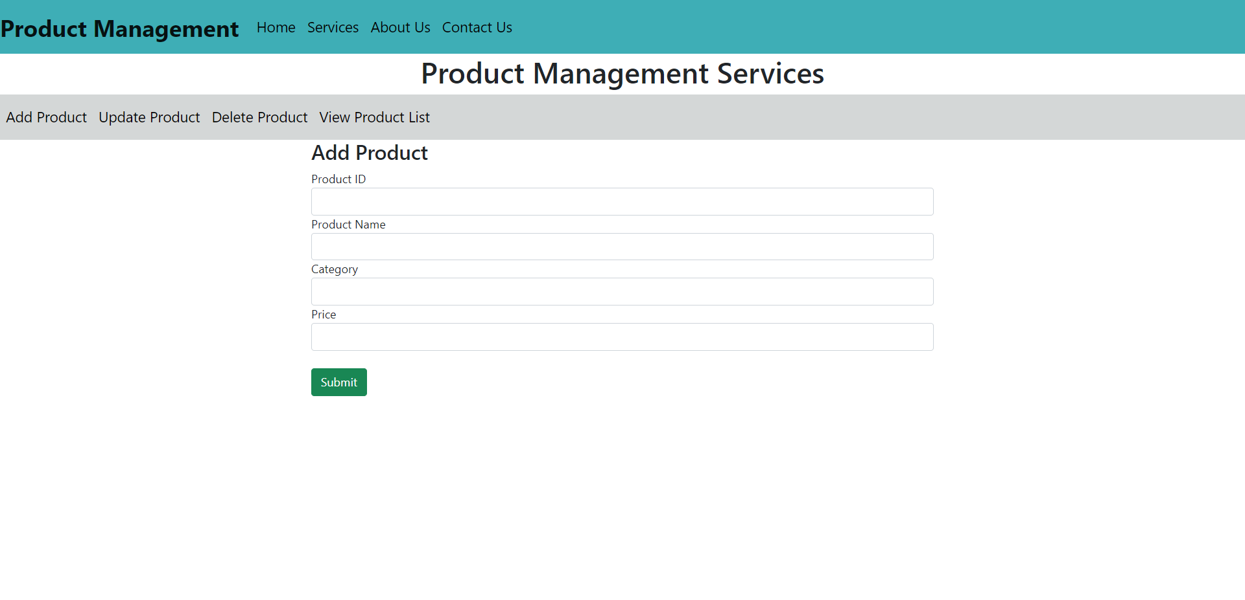
Services - Add product

Slide 8
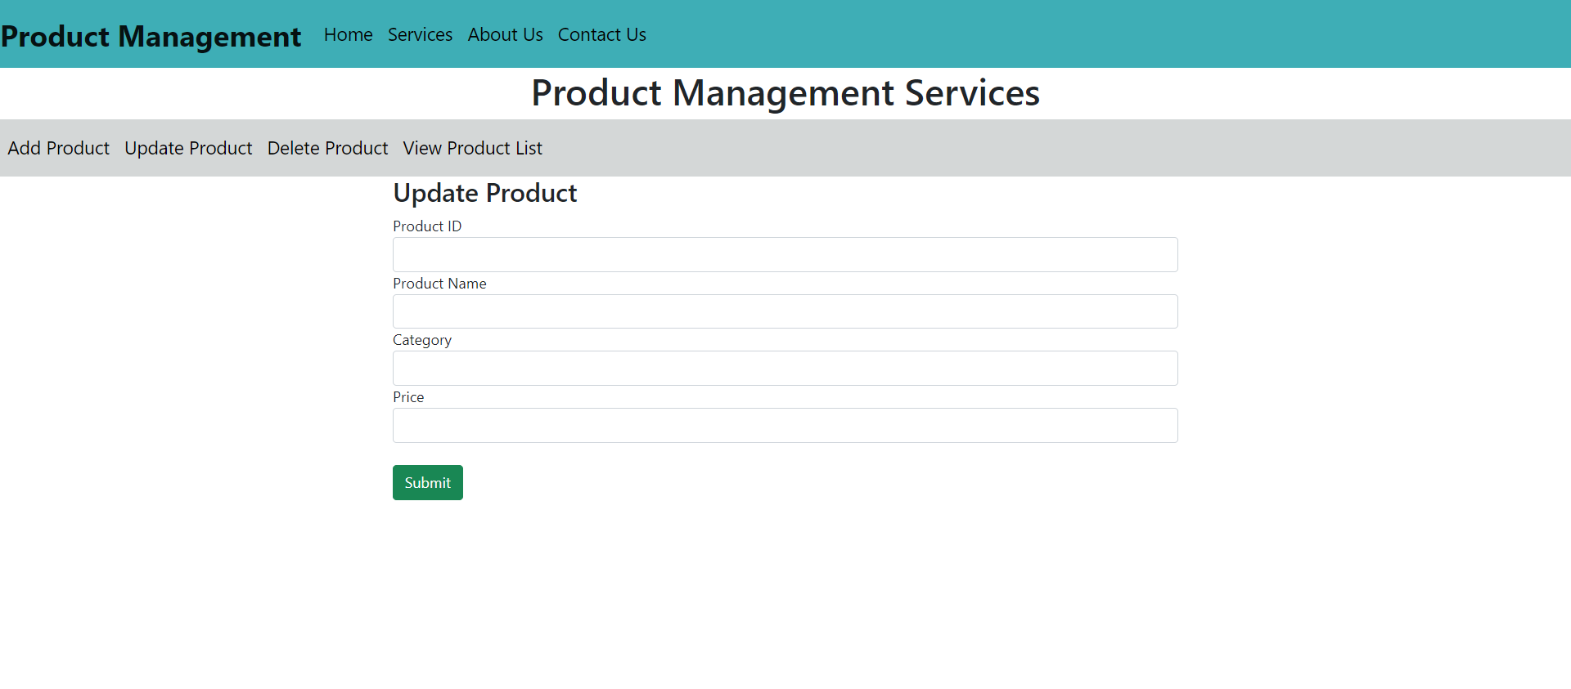
Services - Update Product

Slide 9
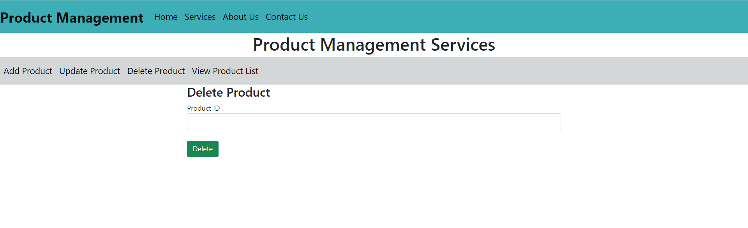
Services - Delete Product

Slide 10
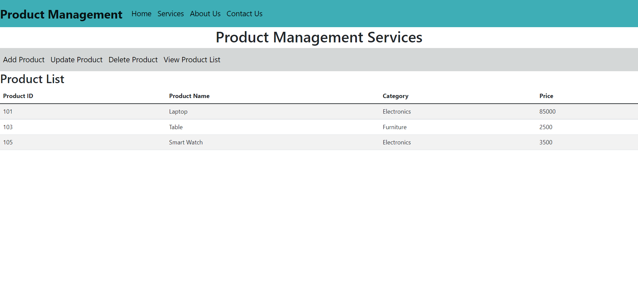
Services - View all products

Slide 11
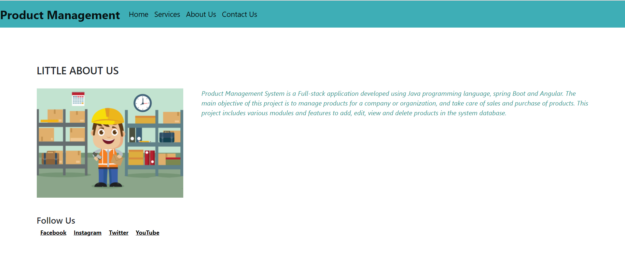
About Us

Slide 12
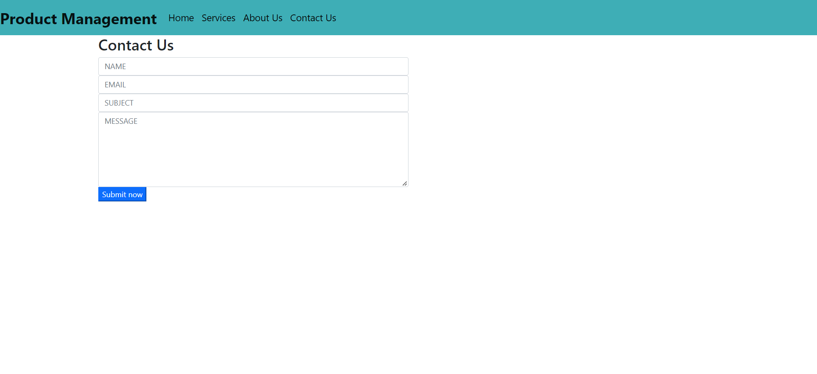
Contact Us

Slide 13
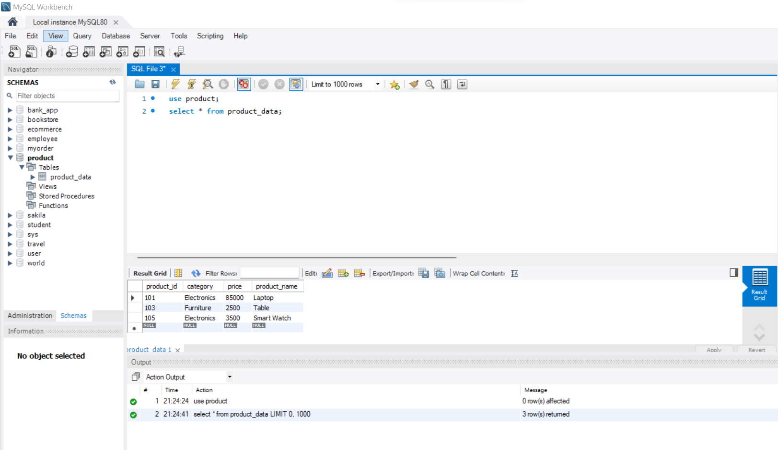
Database

Slide 14
Features
The main objective of this project is to manage products for a company or organization, and take care of sales and purchase of products. This project includes various modules and features to add, update, view and delete products in the system database.
Good product management can help business owners know when its time to reorder materials and minimise cost at the same time

Slide 15
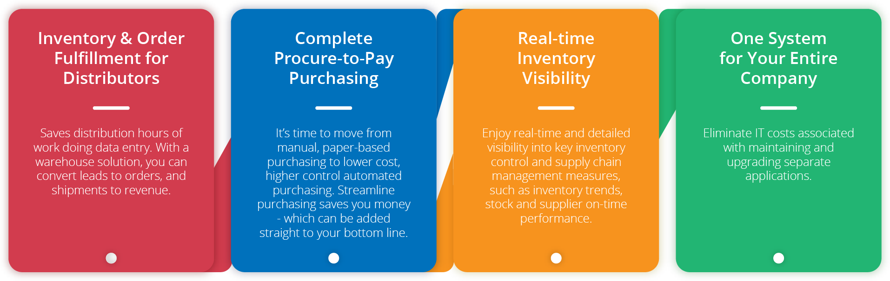
Future Scope

Slide 16
GitHub Link
https://github.com/Archana2303/Full-stack-product-management

Slide 17
THANK YOU

